Slide 1
Algorithms and Data Structures - Part I
STORING AND ACCESSING DATA

Slide 2

Storing and accessing data using arrays
Creating arrays
Adding and updating array data
Enumerating array data
Overview

Slide 3

Time | Reading
06:12:00 | 1

Slide 4

Time | Reading
06:12:00 | 1
06:12:05 | 4

Slide 5

Time | Reading
06:12:00 | 1
06:12:05 | 4
06:12:10 | 3

Slide 6

Time | Reading
06:12:00 | 1
06:12:05 | 4
06:12:10 | 3
06:12:15 | 6

Slide 7
◀ The gauge reading structure
class Reading{
DateTime time;
int value;
}
Reading r1 = Gauge.read(); Thread.Sleep(5000);
Reading r2 = Gauge.read(); Thread.sleep(5000);
Reading r3 = Gauge.read(); Thread.sleep(5000);
Reading r4 = Gauge.read(); Thread.sleep(5000);
Reading r5 = Gauge.read(); Thread.sleep(5000);
◀ Read the gauge data into a variable
◀ Wait 5 seconds
◀ Repeat the read and wait process

Slide 8
5 seconds
1

Slide 9
30 Seconds
1
4
3
6
7
5

Slide 10
1 Minute
1
4
3
6
7
5
2
8
0
9
8
2

Slide 11
1 Hour

Slide 12



Can contain multiple instances of a type

Slide 13
Can contain multiple instances of a type
Numeric indexing
0 1 2

Slide 14
Can contain multiple instances of a type
Numeric indexing
0 1 2
Access individual items

Slide 15
Can contain multiple instances of a type
Numeric indexing
0 1 2
Access individual items
Static or dynamic sizing

Slide 16
Can contain multiple instances of a type
Numeric indexing
0 1 2
Access individual items
Static or dynamic sizing

Slide 17

Can contain multiple instances of a type
Numeric indexing
Access individual items
0
1
2
Static or dynamic sizing
Fixed size once created

Slide 18
Reading[] readings = new Reading[5];
Creating an Array

Slide 19
Reading[] readings = new Reading[5]; readings[0] = Gauge.Read();
Adding Data to an Array

Slide 20
Reading[] readings = new Reading[5];
readings[0] = Gauge.Read(); readings[1] = Gauge.Read();
Adding Data to an Array

Slide 21
Reading[] readings = new Reading[5];
readings[0] = Gauge.Read(); readings[1] = Gauge.Read(); readings[2] = Gauge.Read(); readings[3] = Gauge.Read(); readings[4] = Gauge.Read();
Adding Data to an Array

Slide 22
Accessing Array Data
Reading r = readings[2];

Slide 23
Reading r = readings[2];
for(int i = 0; i < 5; i++) {
Reading r = readings[i];
}
Accessing Array Data

Slide 24

Updating Array Values
readings[2] = Gauge.Read();

Slide 25
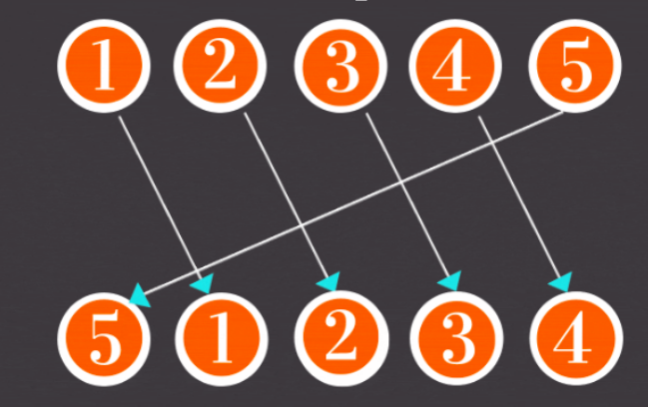

Slide 26



Assisted Practice
Array Rotation

Slide 27
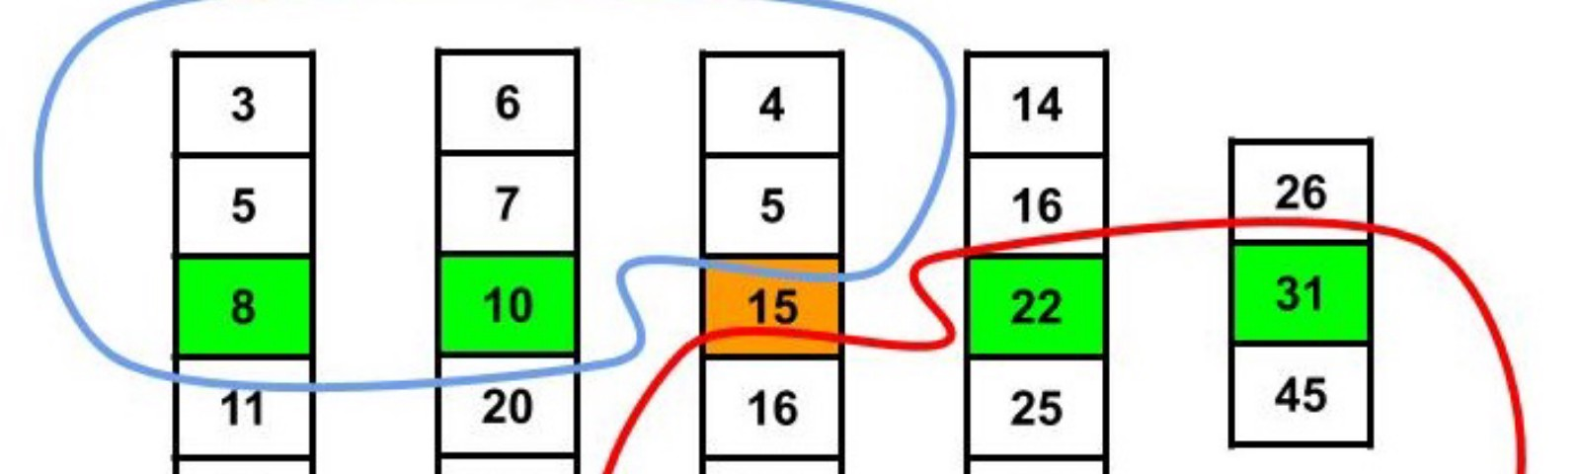

Slide 28
Assisted Practice
Order Statistics
K’th smallest element in an unsorted array using sorting

Slide 29
Assisted Practice
Range Queries
How to query a range in an array and print the [xth, x + yth] most frequent integers in the array?

Slide 30
Assisted Practice
MultiDimensional Array (Matrix)

